Slide 1
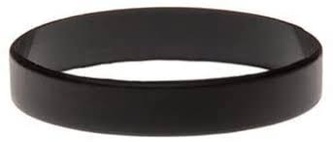


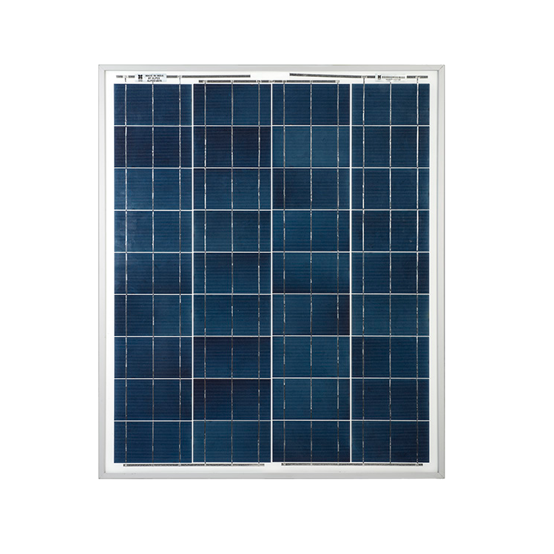
Charge’n’Go
(Solar Panel Charging
Wristband)

Slide 2
Main Idea
The Charge’n’Go solar panel wristband will use solar energy in order to charge your phone
There will be 2 usb ports, allowing 2 devices to be charged at the same time.
The wristband can be adjusted to the customer’s preference.
This product is all-inclusive, meaning that anyone can use this device for their daily lives.

Slide 3
Pricing
The product will be retailed at £14.99
Useful in the energy crisis
One-time payment for a lifetime of use

